Slide 1
DOE’s Building Technologies Office:
R&D Directions and Opportunities
Pat Phelan,* Emerging Technologies
TEES Annual Research Conference
June 7, 2016
patrick.phelan@ee.doe.gov
* On leave from Arizona State University

Slide 2
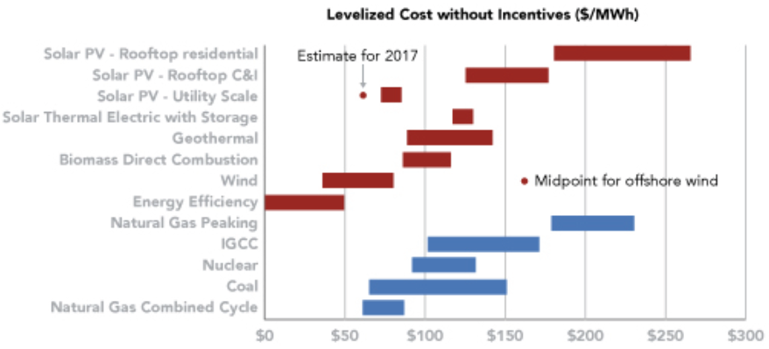
Sustainable Energy ≠ Renewable Energy
Energy efficiency MUST be considered as a part of our sustainable energy strategy!
Source: Advanced Energy Economy (AEE) Institute, “Competitiveness of Renewable Energy and Energy Efficiency in U.S. Markets,” 2015

Slide 3
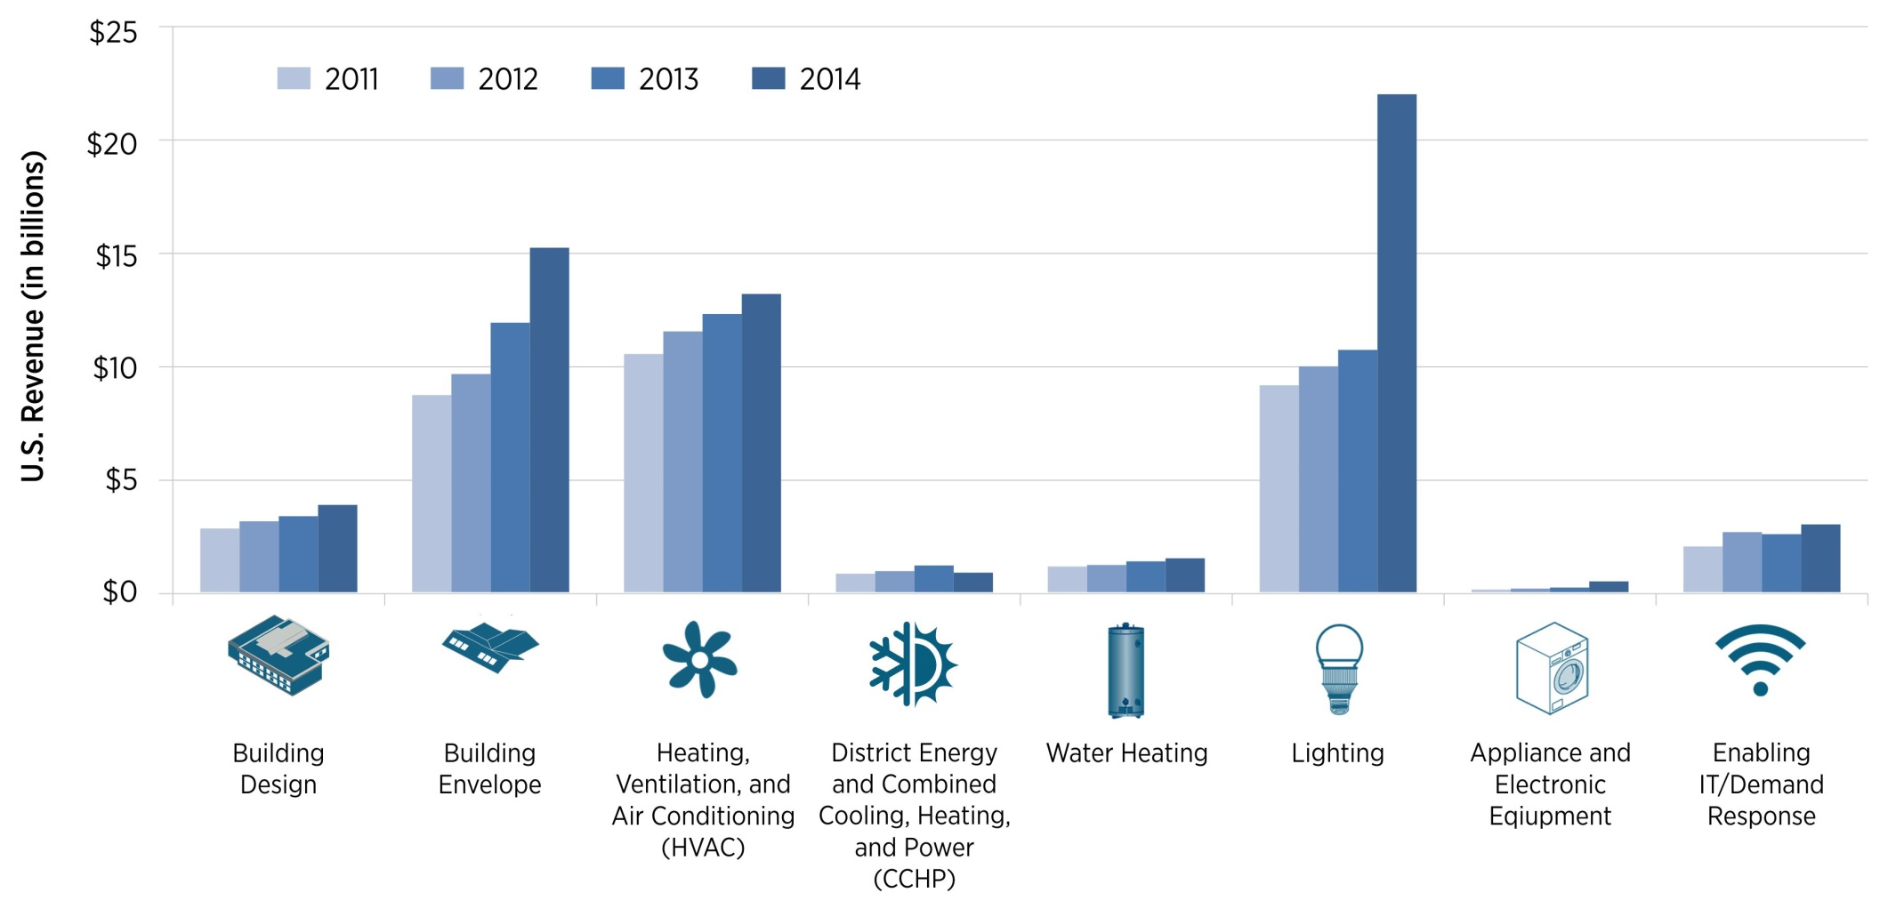
Market Opportunities for Buildings Energy Efficiency
U.S. Revenue by Advanced Building Technology Type
141%
74%
25%
36%
48%
4%
31%
343%
Buildings energy efficiency is the largest advanced energy segment in 2014, in terms of revenue ($60.1B, or 30% of the total).
Source: Advanced Energy Now 2015 Market Report
Notes:
Notes on the report and definitions
Advanced energy definition: a broad range of technologies, products, and services that constitute the best available technologies for meeting energy needs today and tomorrow.
The results must be viewed, however, as a conservative assessment of advanced energy market size.
Navigant Research has used strict definitions within product categories in order to distinguish advanced energy from conventional energy products.
Also, U.S. market revenue counts only domestic sales of products and services and does not include revenue from exports, understating the economic scope of the U.S. advanced energy industry.
2014 Revenue
Building Design: $3.8 billion
Building Envelope: $15.2 billion
HVAC: $13.2 billion
District Energy and CCHP: $850 million
Water Heating: $1.5 billion
Lighting: $22 billion
Appliance and Electronic Equipment: $465 million
Enabling IT/Demand Response: $3 billion

Slide 4
Who Supports Energy Efficiency R&D (Federal)?
Fundamental
Research
First Commercialization
Market
Penetration
Building Technologies Office
Commercial
Buildings
Integration
Codes
&
Standards
Emerging
Technologies
Residential
Buildings
Integration
FEMP
ARPA-E
NSF
ESTCP
ONR
DOE Office of Science
GSA Green
Proving Grounds

Slide 5
Buildings RD&D Opportunities in the 2015 QTR
Building thermal comfort and appliances | Materials that facilitate deep retrofits (e.g., thin insulating materials) Low/no-GWP heat pump systems Improved tools for diagnosing heat flows over the lifetime of a building Clear metrics for the performance of building shells for heat and air flows
Lighting | Test procedures for reliably determining the expected lifetime of commercial LED and OLED products Understanding why LED efficiency decreases at high power densities High efficiency green LEDs Efficient quantum dot materials Advanced sensors and controls for lighting Glazing with tunable optical properties Efficient, durable, low-cost OLEDs Lower cost retrofit solutions for lighting fixtures
Electronics and miscellaneous building energy loads | More efficient circuitry (hardware and software) More flexible power management (hardware and software) Standardized communications protocols Wide-band-gap semiconductors for power supplies
Systems-level opportunities | Accurate, reliable, low installed cost sensors Energy harvesting to power wireless sensors and controls Improved control systems (cybersecurity, install/commissioning) Control algorithms to automatically optimize building system performance Open-source software modules supporting interoperability Easy-to-use, fast, accurate software tools to design and operate buildings Co-simulation modeling with a widely used interface standard Decision science research incorporating personal information security Components and systems that allow building devices to share waste heat
Source: 2015 DOE Quadrennial Technology Review (QTR)

Slide 6
Fundamental Research Challenges in the 2015 QTR
Materials with tunable optical properties (adjust transmissivity and absorptivity by wavelength)
Materials for efficient LEDs
Materials for efficient motors and controls (magnets, wide-band-gap semiconductors)
Enthalpy exchange materials
Materials for low-cost Krypton/Xenon replacement
Materials for non-vapor-compression heat pumps (e.g. thermoelectric, magnetocaloric, electrocaloric)
Big-data management for large networks of building controls and next-generation grid systems
Ultra-efficient computation (neural networks)
Decision science research
Source: 2015 DOE Quadrennial Technology Review (QTR)

Slide 7
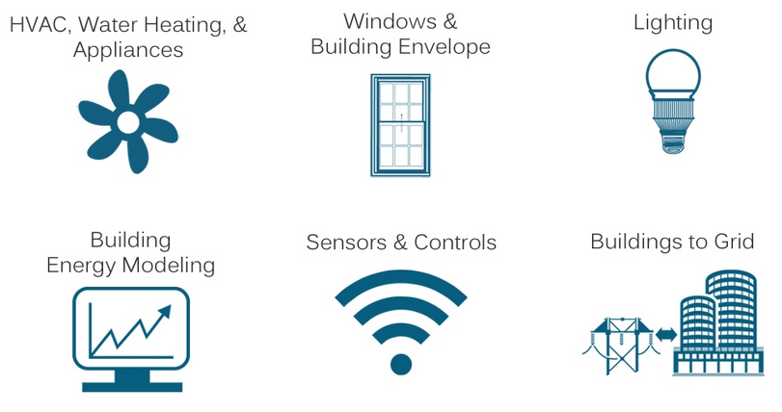
BTO’s Emerging Technologies (ET) Program
http://energy.gov/eere/buildings/emerging-technologies

Slide 8
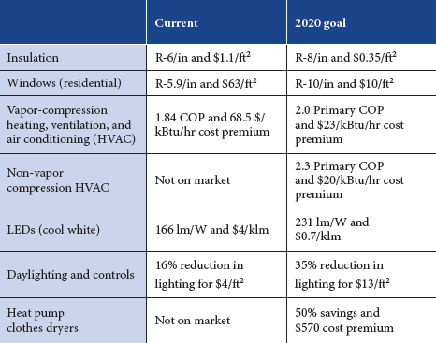
Representative ET 2020 R&D Goals
COP = Coefficient of Performance
COP is based on primary energy input.
Source: 2015 DOE Quadrennial Technology Review

Slide 9
ET Fiscal Year 2016 Budget ($79.912M)
9

Slide 10
Funding Opportunities in FY16
Emerging Technologies:
BENEFIT (Building Energy Frontiers and Innovation Technologies)
  Rotates among non-SSL topics
  Early stage and later stage R&D; often includes “open” topic
Solid State Lighting (SSL) Advanced Technology R&D
General Service Lamps (GSL) R&D
Catalyst (software solutions; joint with SunShot)
ORNL JUMP (hardware)
Small Business Vouchers (SBV)
  Commercial Buildings Integration:
  Annual FOA for demonstration or deployment projects
  Residential Buildings Integration:
  Annual FOA, especially for Building America Program
  Small Business Innovative Research:
  2 – 3 topics offered each year

Slide 11
FY17: Potential Topics of Interest
Solid-State Lighting (SSL)
  Updated SSL R&D Plan was just released
Advanced HVAC&R
  Two workshops last fall (at ASME IMECE and ASHRAE Headquarters)
  Upcoming Request for Information (RFI)
Advanced Controls, including Miscellaneous Electric Loads (MELs) energy reductions
  MELs Workshop last Friday in San Francisco
  Upcoming Request for Information (RFI)
Open Topic

Slide 12
How To Get Involved with BTO
Get on our email list (http://www1.eere.energy.gov/buildings/newsletter.html, and click on “Sign up to receive news and events from BTO”)
Attend the annual BTO Peer Review
Provide feedback on draft roadmaps; currently one available on Building Energy Modeling, and soon one on Sensors & Controls
Volunteer to be a reviewer (send CV to BTOreviewer@ee.doe.gov )
    Apply to a FOA, postdoc, or other funding opportunity! (https://eere-exchange.energy.gov/)
patrick.phelan@ee.doe.gov
Thanks!

